Slide 1

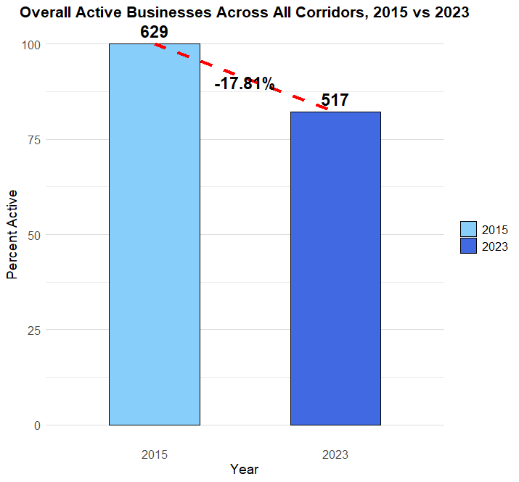
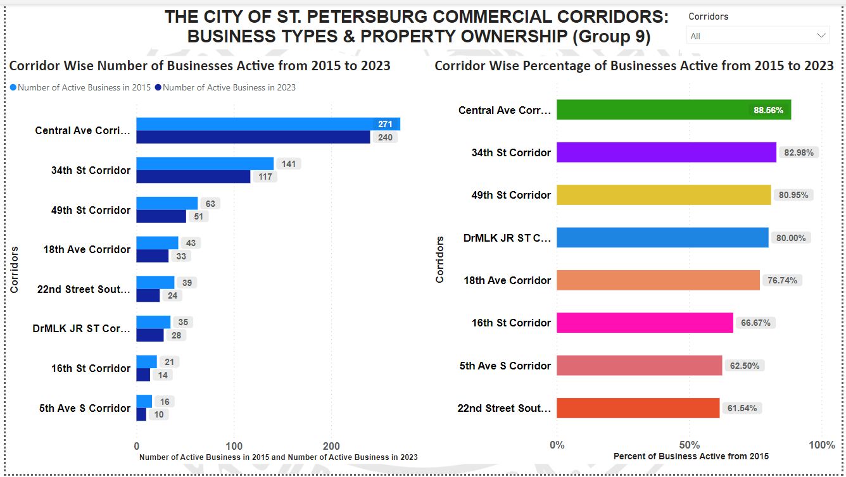
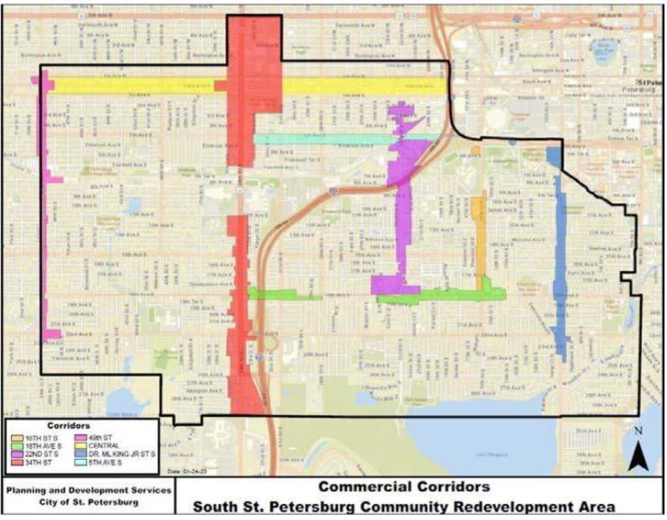
Business Continuity Analysis: Corridors 2015 and 2023
Chandan Patel, Divyanshi Singh, Rahul Bankey, Sri Kumar Dundigalla, Venkata Sai Gagan Deep Alusuri
Business Analytics and Information Systems
Enterprise Information Systems Management and ISM 6155
Introduction
Research Question
Results
The objective of the proposed project is to conduct a thorough examination of the business continuity patterns in St. Petersburg, Florida region.
The following dataset is at our disposal:
City of St. Petersburg’s Business Tax ID Data (For the years 2015 and 2023) for properties on commercial corridors within the South St. Petersburg CRA
The present analysis aims to offer valuable insights into the trends related to business continuity.
The outcomes of this study will hold substantial importance for stakeholders such as policymakers, entrepreneurs, and financiers operating within the locality. The data can be utilized by policymakers to formulate policies that promote the expansion and durability of businesses. Entrepreneurs can utilize the acquired knowledge to make well-informed judgments regarding the expansion of their enterprises and the effective management of obstacles. The data provided can assist investors in making well-informed investment choices within the area.
In general, the proposed project is a crucial measure toward establishing a conducive commercial environment in St. Petersburg, Florida, and promoting economic advancement in the locality.
Analyze business continuity trends on each corridor - based on continuously active businesses:
How many businesses (#) that were active on each corridor in 2015 are still active on the corridor?
What percent of businesses that were on each corridor in 2015 are still active on the corridor?
Methodology
The Duplicate businesses were handled based on the "CONTROL #" column from each year making sure we count only the distinct businesses.
Combined corridors if they had a business presence in more than one corridor. For example, “Within 18th Ave Corridor AND Within 34th St Corridor” and the businesses that were present in the new category were counted.
We merged the two sheets for each year using a left join (based on Control #, Pin, or address) to make sure that all the businesses were present in the 2015 file and only businesses matching the condition in the 2023 file were retrieved.
Filtered the merged file to have only "Active" businesses. Now the file had 12 corridors (including the counts of businesses that were present in more than one corridor).
To get to the final 8 corridors, we aggregated the 12 corridors on the number of businesses active in 2015 and still active in 2023.
The percent of active businesses was calculated for all 8 corridors based on the count of businesses still active in 2023 compared to the count of businesses active in 2015.
Visualization Tools used: MS Excel, Power BI
Analytical Tool used for data manipulation : R- Studio
Figure 2. Analysis of Active Businesses in St. Petersburg Commercial Corridors: Comparison of 2015 and 2023 Data for Business Types, Property Ownership, and Percentages.
Figure 3. Comparison of overall business activity in South St. Petersburg CRA corridors between 2015 and 2023 .
Overall, the percentage of active businesses in 2023 is high across all corridors, with the lowest being 61.5% and the highest being 88.6%. This suggests that the business climate in these corridors is relatively stable.
The Central Ave Corridor has the highest percentage of active businesses in 2023 at 88.6%. This may indicate that the businesses in this corridor are more established and have a better chance of staying open over the long term.
The 16th St Corridor has the lowest percentage of active businesses in 2023 at 66.7%. This may indicate that the businesses in this corridor have a harder time staying open over the long term, potentially due to competition or other factors.
Across all corridors, there is some attrition in the number of active businesses from 2015 to 2023. However, the fact that most corridors have a percentage active above 80% suggests that the majority of businesses are able to stay open over the long term.
It would be interesting to investigate why some corridors have a higher percentage of active businesses in 2023 than others. Potential factors to explore could include demographics, economic conditions, and zoning regulations.
Conclusions
The overall decline in active businesses between 2015 and 2023 is 17.81%, with a total of 112 businesses closing down. The total number of active businesses in 2015 was 629, while in 2023, it was 517.
These results suggest that some corridors have been more successful in maintaining their business activity than others. It would be useful to investigate the reasons behind this variation and consider interventions that could support struggling businesses.
References
St. Petersburg Economic Development. (n.d.). Community
Redevelopment Areas. City of St. Petersburg, Florida.
Retrieved from
https://www.stpete.org/business/economic_development/community_redevelopment_areas.php
Power BI Report. (n.d.). [Report section title]. Power BI
Group: me. Retrieved from
https://app.powerbi.com/groups/me/reports/e84748ff-f5e0
4f7e-9ada-6fa6c28fd9a8/ReportSectionee58fd2c2d6069357086
Figure 1. Commercial Corridors in the South St. Petersburg Community Redevelopment Area.

